Slide 1
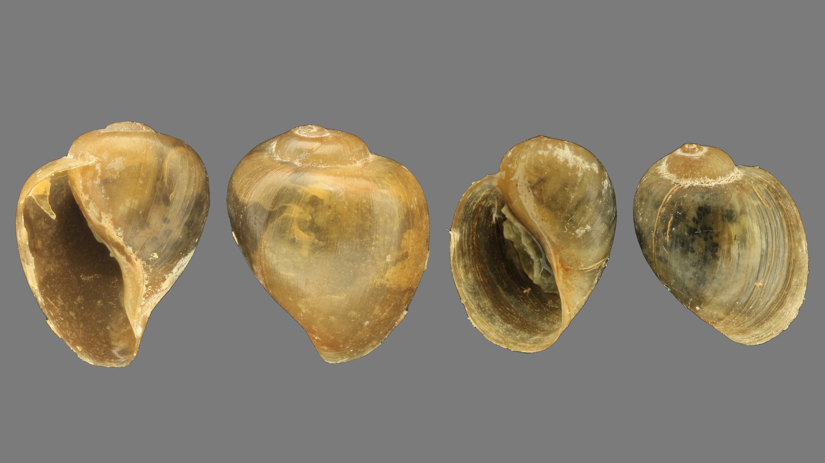
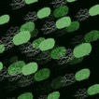
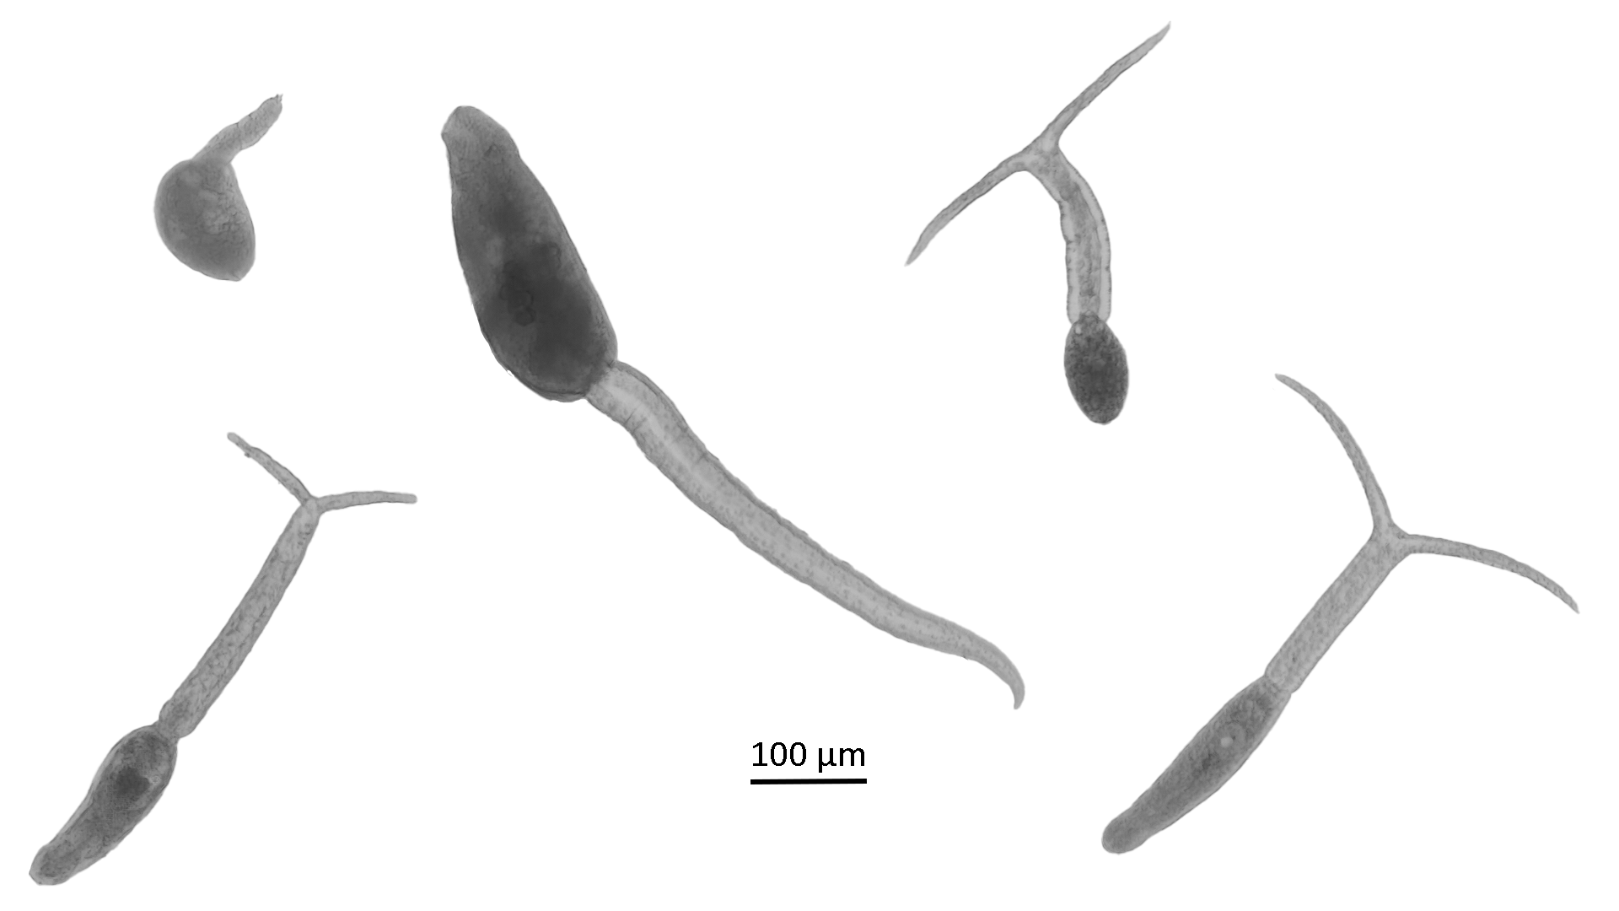
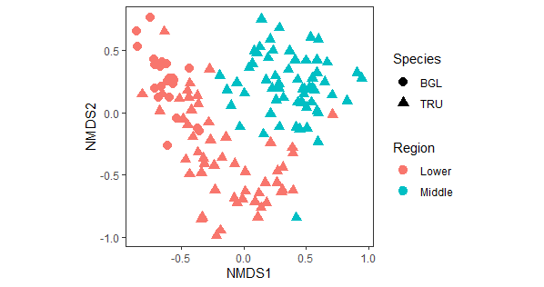
Towards a better understanding of the snail-trematode-microbiome interactions driving schistosome transmission in Senegal Ruben Schols^{1,2}, Cyril Hammoud^{1,3}, Ruben Put², Arthur Piot², Tim Maes², Bruno Senghor⁴, Ellen Decaestecker², Tine Huyse¹
¹The Royal Museum for Central Africa, ²KULeuven, ³UGhent, ⁴Cheikh Anta Diop University
Background In the lower part of the Senegal River Basin (SRB), B. globosus acts as the main snail host for Schistosoma haematobium, whereas B. truncatus does not transmit local S. haematobium strains^{1,2}. In the upper valley and possibly middle valley, however, the situation is reversed^{2,3}.
Results
Snails
Almost 2,000 snails collected, comprising of eight snail species. Almost 800 specimens were B. truncatus (86%) or B. globosus (14%).
No B. globosus in the middle valley.
Trematodes
138/700 tested snails (20%) released cercariae, of which 66 (48%) Schistosoma spp. and 16 (12%) co-infections.
Five cercarial morphs detected (Fig1).
Microbiome
The microbiome of 115 B. truncatus, 23 B. globosus and one negative were characterized.
Snail species and region of origin in the SRB significantly affected alpha and beta diversity (Fig2).
The alpha diversity of B. truncatus was significantly lower in the middle valley compared to the lower valley.
The alpha diversity of B. truncatus was significantly higher compared to B. globosus.
Bacterial genera of the phyla Firmicutes (2) and Proteobacteria (6) overrepresented in infected snails compared to non-infected snails, while 13 additional Phyla (138 genera) showed the opposite pattern.
Research question
Which factors drive snail host susceptibility to S. haematobium infections?
Aims
To characterize the microbiome and trematode communities of B. truncatus and B. globosus along the SRB and link this to susceptibility towards schistosome infection.
A)
C)
D)
Materials & Methods
Snails were collected in 2012, 2014 and 2021 from 20 sites across the SRB, followed by shedding. All snail and cercarial morphotypes were photographed prior to DNA extraction. Infections were detected and characterized through shedding and an RD-PCR protocol⁴.
The microbiome was characterized through a 16S metabarcoding and subsequent data analysis was based on Houwenhuyse et al.⁵ and Janssens et al.⁶.
Hosts and (co-)infecting trematodes will be characterized through the high-throughput amplicon sequencing (HTAS) protocol of Hammoud et al.⁷.
B)
E)
Fig 1: A) Xiphidiocercaria, B) Schistosoma sp., C) Echinostome, D) Brevifurcate-apharyngeate distome and E) longifurcate-pharyngeate distome.
Conclusion The HTAS protocol in combination with the microbiome data presented here will determine what drives snail host susceptibility to S. haematobium in the SRB.
Transplant experiment to disentangle causation from correlation.
Fig 2: NMDS plot showing the microbiome beta diversity of B. truncatus (TRU) and B. globosus (BGL) for the lower and middle valley in the SRB.
MicroResist project:
¹Picquet M., J.C. Ernould, J. Vercruysse, V.R. Southgate, A. Mbaye, B. Sambou, M. Niang and D. Rollinson (1996), The epidemiology of human schistosomiasis in the Senegal river basin, Trans. R. Soc. Trop. Med. Hyg., 90, 4, Pages 340–346.; ²Sène M, Southgate VR and Vercruysse J (2004) Bulinus truncatus, intermediate host of Schistosoma haematobium in the Senegal River Basin, Bull. Soc. Pathol. Exot., 97, 29–32.; ³Southgate, V., de Clercq, D., Séne, M., Rollinson, D., LY, A. and Vercruysse, J. (2000). Observations on compatibility between Bulinus truncatus and Schistosoma haematobium in the Senegal river basin. Ann. trop. med. parasitol. 91, 371–378.; ⁴Schols, R., Carolus, H., Hammoud, C., Mulero, S., Mudavanhu, A. and Huyse, T. (2019). A rapid diagnostic multiplex PCR approach for xenomonitoring of human and animal schistosomiasis in a ‘One Health’ context. Trans. R. Soc. Trop. Med. Hyg., 113(11), 722–729.; ⁵Bulteel, L, Houwenhuyse, S, Declerck, S and Decaestecker, E. (2021). The Role of Microbiome and Genotype in Daphnia magna Upon Parasite Re-Exposure. Genes. 12. 70.; ⁶Janssens, L, Van de Maele, M, Delnat, V, Theys, C, Mukherjee, S, De Meester, L and Stoks, R. (2022). Evolution of pesticide tolerance and associated changes in the microbiome in the water flea Daphnia magna. Ecotoxicol. Environ. Saf.. 240. 113697.; ⁷Hammoud, C, Mulero, S, Van Bocxlaer, B, Boissier, J, Verschuren, D, Albrecht, C and Huyse, T. (2021). Simultaneous genotyping of snails and infecting trematode parasites using high‐throughput amplicon sequencing. Mol. Ecol. Resour. 22.
Copyright © 2022 Schols et al., ruben.schols@africamuseum.be
5-minute talk @ 22/08/2022, 16:25-16:30 (PA03-05 - 2.2 Schistosomiasis)

